Slide 1
Hand designed reflexes present before training
Agent trained on top of the reflex
Problem:
How to find good reflexes automatically for every environment?
(run for million steps)

Slide 2
How to design reflexes for this?

Slide 3
Algorithm 1:
Train base network first
Train the fast (reflex) network:
Reward:
(-abs(TD) + reward) if next state for reflex is the next state for the base network
0 otherwise
s₁
s₂
Base network step
S_{1.5}
Method | Performance
Base network | 162.9
Reflex network (TD) | 155.21
Reflex network (reward) | 99.768
Reflex network (TD + reward) | 85.7
Reflex step
Reflex step

Slide 4
Algorithm 2:
Train base network first
Train the fast (reflex) network:
Reward:
(ΔTD + reward) at every step
s₁
s₂
Base network step
S_{1.5}
Method | Performance
Base network | 162.9
Reflex network (TD) | 155.61
Reflex network (reward) | 160.65
Reflex network (TD + reward) | 153.116
Reflex step
Reflex step
This is training a faster network on top of slower network normally

Slide 5
Algorithm 3:
Train base network first
Train the fast (reflex) network such that:
If TD > threshold, create an episode of length = 2 steps of the base network
s₁
s₂
Base network step
Reflex step
Reflex step
Reflex step
0
Method | Performance
Base network | 162.9
Reflex network (TD) | 146.64
Episode start
TD difference calculated wrt. Start of episode
TD > threshold noted
reward

Slide 6
Actor (slow A⁰)
Actor (Fast A¹)
TD⁰
TD¹
A⁰
+
A¹
Critic (slow)
Critic (Fast)
Compound action
State
reward
Environment
Action

Slide 7
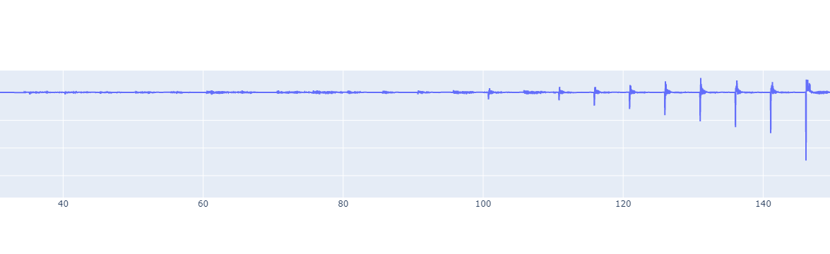
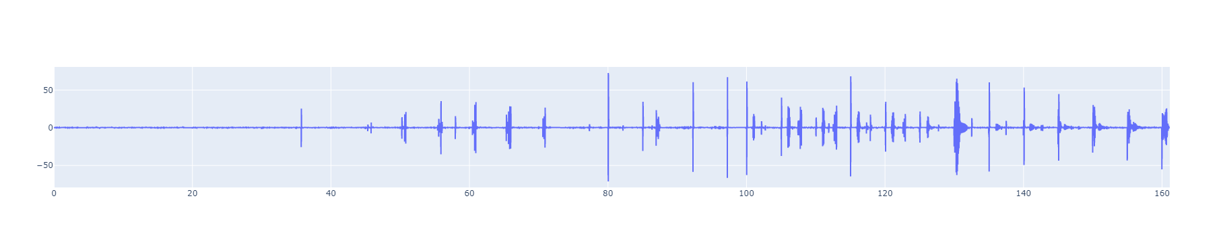
TD-Error on 0.04 network (trained on 8G)

Slide 8
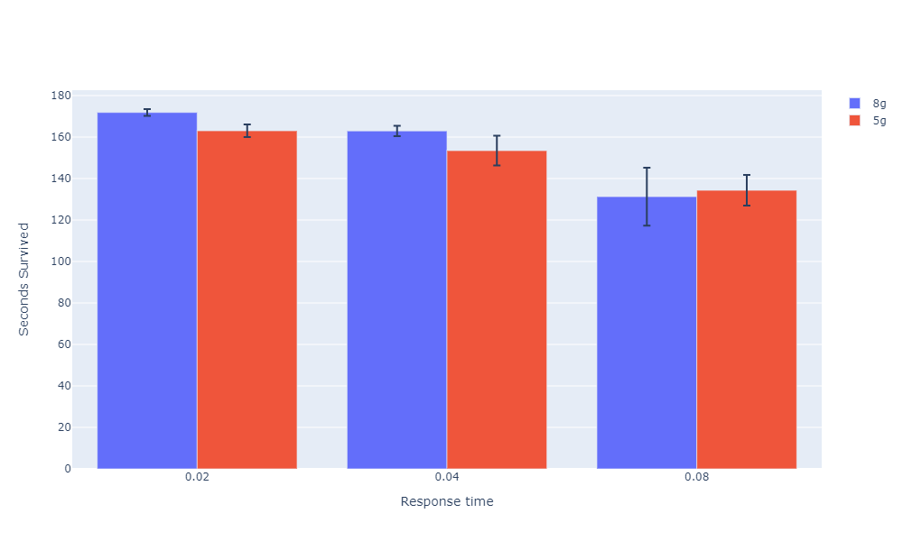
Averaged over 10 seeds and 10 episodes

Slide 9
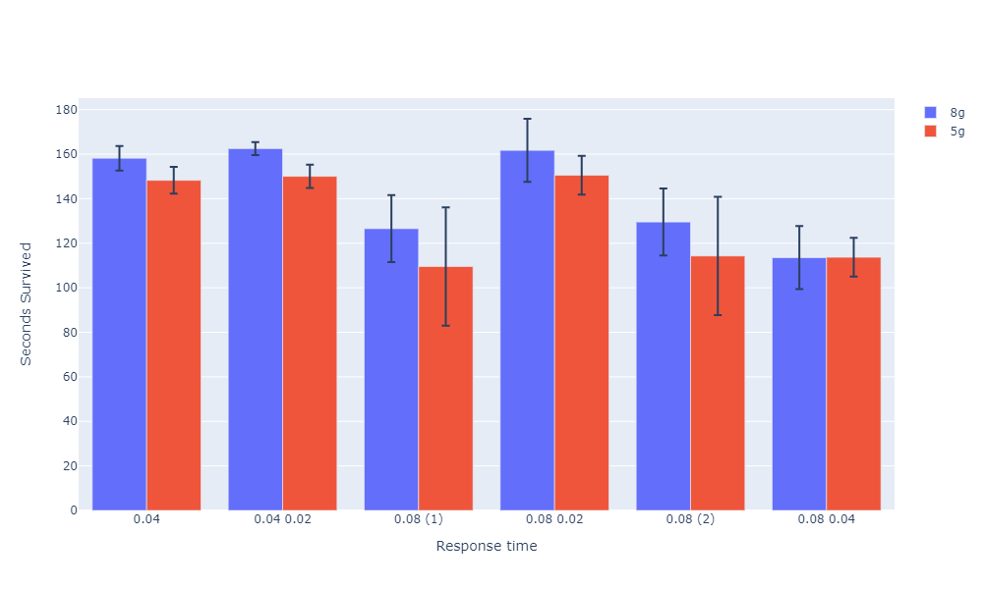
Averaged over 10 seeds and 10 episodes
Faster network trained normally over slower network

Slide 10
To check
Check few shot learning with reflexes
Transfer reflexes
Reflexes prevent negative rewards.
Add parent action and child action in state representation.
Slowly add reflexes on a trained network (while training it again).
Make parent network’s actions come in faster at dying states or states that have a drastic change in reward.

Slide 11
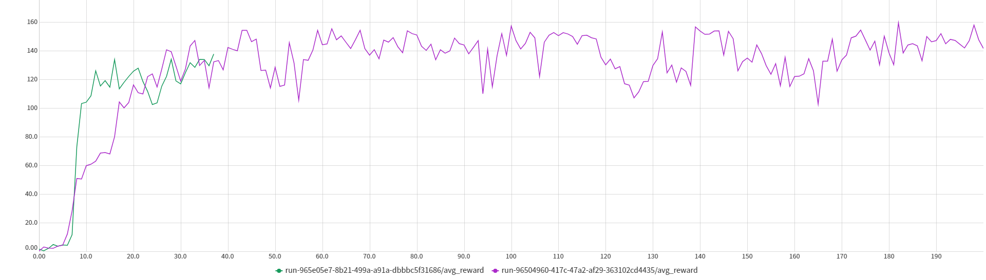
Approach on edge cases
Train a neural network on states that result on failure on the Teacher network.
Pick the same action but faster.
Neural network: 6 hidden neurons

Slide 12
Other summer works
DITTO
Submit to AAAI
Work on thesis proposal (due next sem)

Slide 13
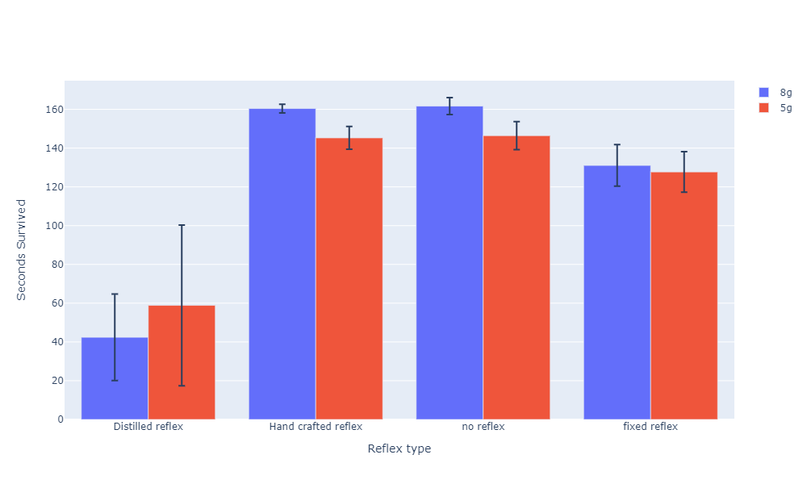
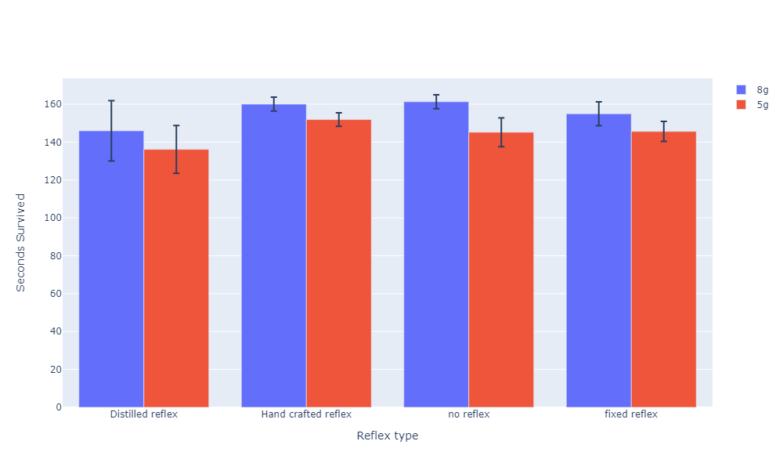
Reflex added after training
Reflex added before training

Slide 14
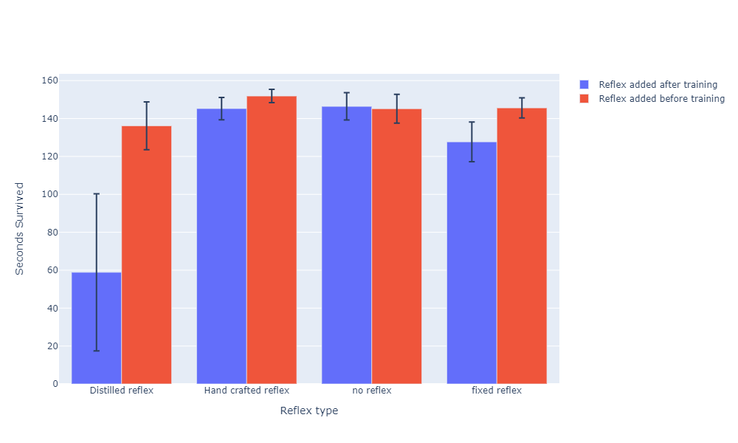
Averaged over 10 seeds and 10 episodes
5g pertubation

